Slide 1
Fluid Power Systems
BY Dr. OMARI MASHI KHALFAN
MEVLANA UNIVERSITY, MECHANICAL ENGINEERING DEPT.

Slide 2
COURSE CONTENTS
In this course, the following topics will be covered:
1. Orientation
-Introduction to fluid power
-Hydraulic systems
-Pneumatic systems
-Types of power transmission systems
-Advantages of fluid power systems over others
-Applications of fluid power systems

Slide 3
COURSE CONTENTS
2. How fluid transmits power?
Pascal Theorem
Concept of Bulk Modulus
Concept of fluid Viscosity
Cavitation
Fluid power formulas
3. Fluid Power Components
Hydraulic valves
Pumps
Actuators (cylinders and motors)

Slide 4
COURSE CONTENTS
4. Fluid Power Circuits
-Hydraulic circuit symbols
-Basic hydraulic circuits

Slide 5
Recommended Text Books and Reading Materials
1. Fundamentals of Fluid Power Control(By John Watton)
2. Fluid Power Circuits and Control-fundamentals and applications(By: John S. Cundiff )
3. Hydraulic Power System Analysis(By Arthur Akers, Max Gasmann and Richard Smith)

Slide 6
WHAT IS FLUID POWER?
Fluid power refers to transmission and control of energy by means of pressurized fluid.
The term fluid designates liquid or gas. If the fluid power system involves liquid, it’s called Hydraulic System but, if the medium used in the fluid power system is air (gas) then the system is known as a Pneumatic System.
Essentially fluid power is used for convenience in converting mechanical power to fluid power and back to mechanical power.

Slide 7
Power transmission systems
There are three types of power transmission systems:
Mechanical power transmission system (gear boxes, pulleys, levers)
2. Electrical power transmission system (cables, wires)
3. Fluid power system (fluid)

Slide 8
ADVANTAGES OF FLUID POWER
Fluid power systems offer high power at correspondingly small weights of its components
Easy and accurate control of actuators.
Actuators in fluid power can have enormous speed range and be reversed when needed.
Capable of producing a high and constant torque regardless of speed changes.
Single source of fluid power (pump) is capable of operating several systems at once
Can be operated at hazardous environments

Slide 9
DISADVANTAGES OF FLUID POWER
Leakage and pump cavitation in hydraulic systems tend to lower their efficiency
The system needs careful handling against particle contamination hence filtering is necessary

Slide 10
WHAT IS THE MAGIC BEHIND FLUID POWER SYSTEMS?
The secrecy behind fluid (in this case, liquid) being able to multiply force and hence become capable of accomplishing useful work lies under two facts:
Pascal Theory
Incompressibility of Liquid

Slide 11
1. PASCAL THEORY
Pascal Theory states that pressure of an incompressible fluid in a confined system travels undiminished at every point within the system.
That means, if we put a liquid in a container and apply force at one point, the force will create some sort of pressure over the area where the force has been applied and that pressure will be the same everywhere within the confined liquid.
Mathematically; the theory can be expressed as:
P = F / A

Slide 12
Pascal theory
Where ;
P is pressure defined as force per unit area and measured in Newtons per square metres (N/m² which is equivalent to Pascal Pa).
F is the applied force in Newtons (N)
A is the area in square metres (m² ) over which the force is applied.

Slide 13
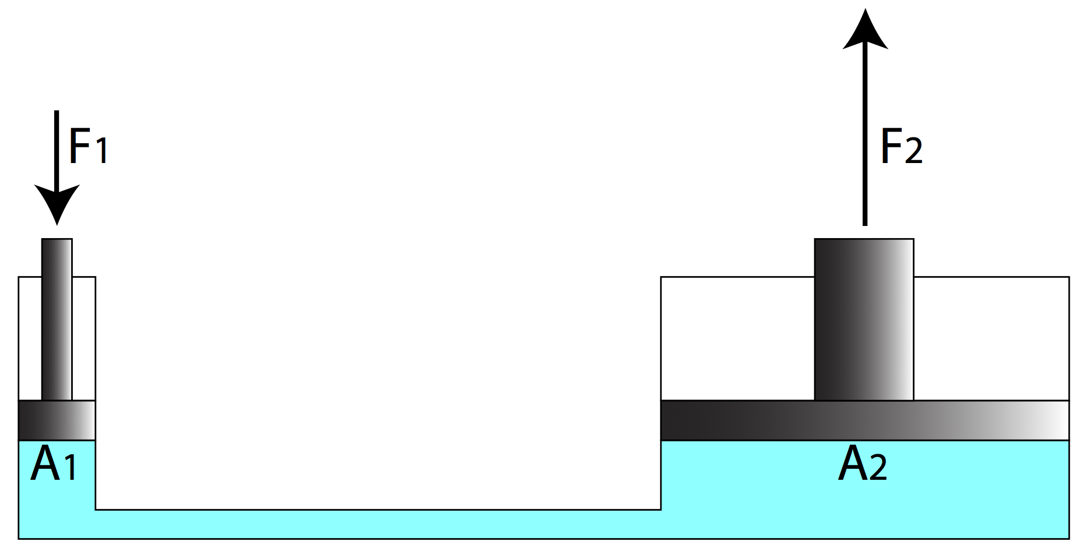
DEMOSTRATING APPLICATION OF PASCAL THEORY [1]

Slide 14
DEMOSTRATING APPLICATION OF PASCAL THEORY
The above pictorial presentation shows application of the Pascal Theory where a small force of F₁ is applied on a confined fluid over an area of A₁, but the pressure created on the fluid can be used to obtain large force of magnitude F₂ if the fluid is allowed to act on a large area, A₂.
Here ,we can see that the hydraulic system can be used to multiply force in the sense that a small force can be applied over a small area (for instance a hydraulic hose), but by making use of the Pascal Theory, the pressure created by the small force within the liquid can be exposed over a relatively large area (for instance on a piston of a hydraulic cylinder) and thus resulting in a very large force.
In this context, the concept can be termed as a mechanical advantage of the hydraulic system.

Slide 15
2.INCOMPRESSIBILITY OF LIQUID
Another factor that enables fluid power systems to demonstrate wonders in today’s sophisticated industrial applications is their tendency to resist shear forces. We can’t simply cut through a confined fluid. The fluid will tend to move (thereby pushing anything along its way) as far as its compressibility allows it.
This is particularly the case in Hydraulics, where the liquid used (hydraulic oil) generally shows negligible change in its density and hence considered incompressible.
In other words, we can apply high pressures on Hydraulic systems (between 100 and 350 Bars) which can result in higher forces necessary for lifting, lowering, compacting, forming or pushing applications without affecting the force transmitting medium (hydraulic oil) in the system.

Slide 16
2.INCOMPRESSIBILITY OF LIQUID
On the other hand, Pneumatic systems have limited pressure ranges (around 2 to 8 Bar). This is due to the fact that air is compressible, therefore only applications involving relatively lower pressures can be handled nicely with Pneumatic systems.
But pneumatic systems have the advantage of having quick responses than their hydraulic counterparts.
Due to their light and simple construction, Pneumatic components are cheaper than hydraulic system components.

Slide 17
BASIC HYDRAULIC SYSTEM
Generally speaking, a basic hydraulic system consists of the following components:
Hydraulic pump
Pressure relief valve to protect the system against extreme pressures
Prime mover to drive the pump

Slide 18
Control valve to route the oil to the actuators
Actuators (users) that use fluid pressure to do mechanical works
Hydraulic tank to store the fluid
Fittings and Hoses to help conveying the fluid to required points.

Slide 19
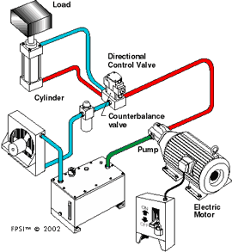
EXAMPLE OF A HYDRAULIC SYSTEM[2]

Slide 20
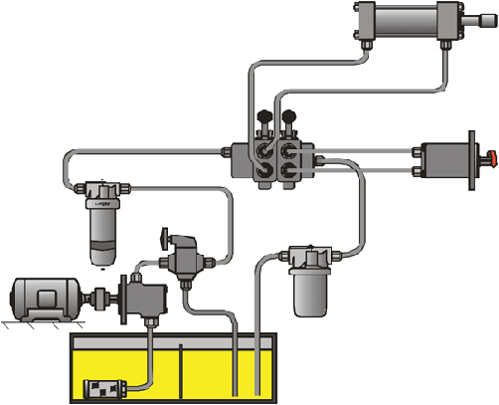
HYDRAULIC SYSTEM WITH TWO ACTUATORS [3]
Directional Control Valve
Pressure Line Filter
Actuators
Pump
Return Filter
Electric Motor
Pressure Relief Valve
Suction Strainer

Slide 21
FUNCTIONS OF COMPONENTS IN A HYDRAULIC SYSTEM
Pump is among the most important components in a hydraulic system. Its function is to create flow of the hydraulic oil to the system.
Prime Mover; this refers to electric motor or an internal combustion engine whose function is to provide mechanical energy to drive the pump.
Suction Strainer, it’s a means of filtering. The device filters coarse solid materials and prevents them from reaching the pump.
Actuators; these are devices that use the fluid pressure and velocity to do mechanical works. They are either linear actuators known as cylinders or rotary actuators termed as hydraulic motors.
Coolers; Hydraulic systems are almost always susceptible to overheating . This is prevented by incorporating an oil cooling device to lower the operating temperatures of the liquid.

Slide 22


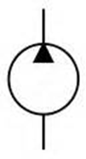
Hydraulic Circuit Symbols
Hydraulic system components are represented by their internationally recognized symbols. Some of these symbols are shown below:
Hydraulic Tank (reservoir)
Variable Displacement Pump
Fixed displacement pump
Fixed Displacement Pump

Slide 23




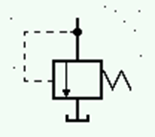


Hydraulic Circuit Symbols
Hydraulic line Flexible line
Pilot line line connection
Filter
Pressure Relief Valve
Two way – two position valve (2/2)
Four way, three position valve (4/3)

Slide 24
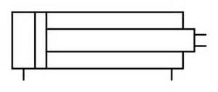
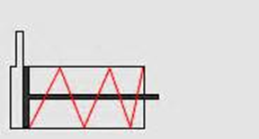
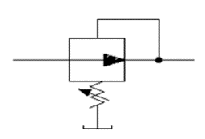
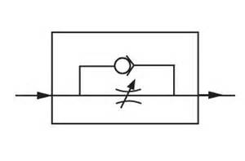
Hydraulic Circuit Symbols
Double acting cylinder
Single acting cylinder
Pressure reducing valve
Flow control valve + check valve

Slide 25
HYDRAULIC CIRCUITS
Hydraulic circuits are schematic representations of the components used in a hydraulic system and their inter-relations on the functioning of the system as a whole.
They give an insight of which devices the system contains.
They also help in troubleshooting if the system develops a breakdown and someone else has to deal with the problem.

Slide 26
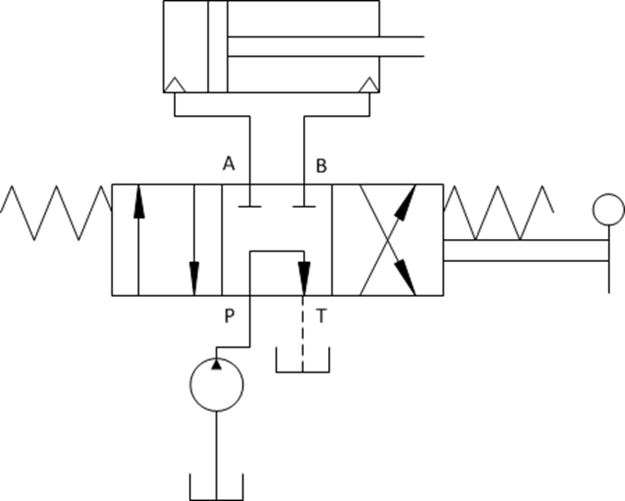
Simple Hydraulic Circuit

Slide 27
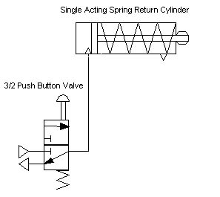
Actuating a single acting cylinder
Pneumatic System
Hydraulic System

Slide 28
Pump Unloading Circuit
This type of hydraulic circuit is used to unload pump (i.e. directing pump flow to tank at a low pressure) when a required pressure in the system is reached. It incorporates an unloading valve which principally operates as a pressure relief valve but at a relatively lower pressure. This circuit is used:
when an accumulator is used with a closed centre valve, or
when two pumps (high-low) are used together and one is to be unloaded after a certain pressure value .

Slide 29
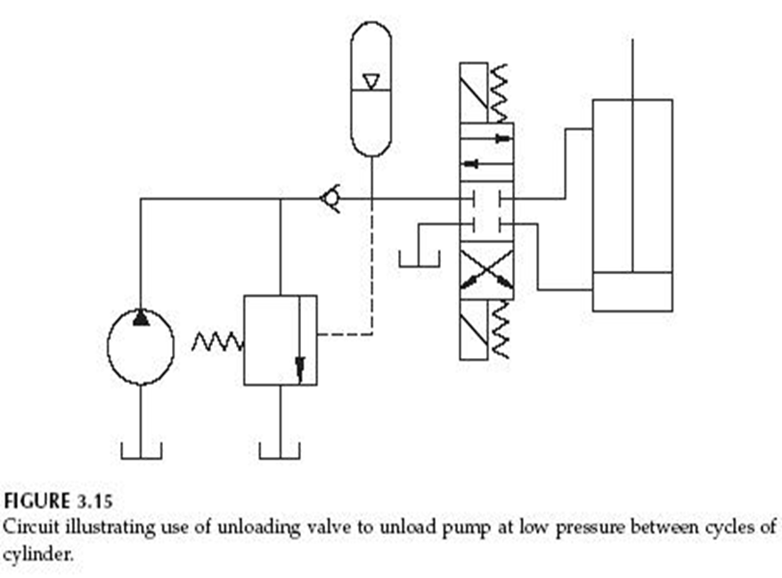
1.Unloading Circuit with Accumulator
Accumulator
Unloading Valve

Slide 30
2. Unloading Valve with Hi-lo Pumps
Pressure Relief Valve
Unloading Valve

Slide 31
Cylinder Locking Circuit
In most heavy duty hydraulic presses, the press table connecting the cylinder needs to be locked in place when the press is off duty.
This is achieved by incorporating a double check pilot operated valve in the system.
In this way, the table (cylinder) remains in its required position and no external load (such as the table’s weight) can move it.

Slide 32
Cylinder Locking Circuit
Pilot Operated Double Check Valve

Slide 33
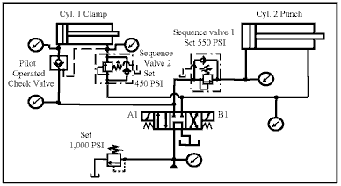
Sequential Circuit

Slide 34
Sequential Circuit
This circuit is used when two operations are to be performed one after the other.
Generally; the one with low pressure demands starts while the higher pressure demanding operation waits until the pressure of the former exceeds the set limit.
This process is achieved with a sequential valve connected in series with the directional control valve.

Slide 35
CONTROL OF A FLUID POWER SYSTEM
In a fluid power system, we are expected to control the pressure and flow rate of the fluid as well as motion of the actuators ( speed and directions of hydraulic cylinders and motors). This function is accomplished with the valves.
There are different types of control valves in fluid power systems, grouped as
Pressure Valves
Flow Valves
Directional Control Valves

Slide 36
PRESSURE VALVES
These are fluid power valves dealing with controlling pressures, they include:
Pressure Relief Valves
Pressure Reducing Valves
Unloading Valves
Counter Balance Valves
Sequential Valves
Each of these valves has a specific and peculiar way of functioning in the system.

Slide 37
FLOW VALVES
These valves are used to control the flow rates of a fluid system. In other words, they are responsible for the speed at which an actuator operates.
They operate by increasing or decreasing the valve orifices where the fluid passes.
It should be noted that frequent operations of these valves lead to overheating problems, as the fluid faces resistance (friction) whenever the orifice constricts.

Slide 38
DIRECTIONAL CONTROL VALVES
As the name implies, these valves are used in fluid power systems to control the directions to which an actuator moves.
Here one –way valves (or check valves) can also be considered as being directional valve types.
There are several ways of controlling these valves, but mostly they are either manually controlled or by using electrically operated solenoids.

Slide 39
MANUALLY CONTROLLED VALVES[4]
Simple hydraulic systems and most mobile hydraulic applications involve manually operated valves to control actuators.

Slide 40
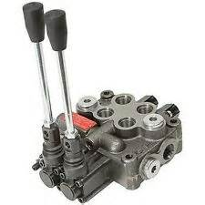
Manually operated directional control valve

Slide 41
SOLENOID OPERATED VALVES
In most industrial applications of fluid power, solenoid operated valves are commonly used. Not only the directional control but also pressure control valves tend to use electrical signals to activate the valves. This is generally the case when automated systems are to be controlled.
The solenoid operated valves are stacked on valve manifolds containing several precision drilled holes to route fluid to different locations.

Slide 42
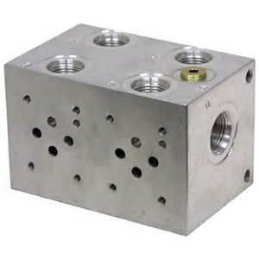
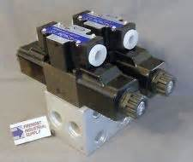
SOLENOID VALVES AND MANIFOLD BLOCK[4]

Slide 43
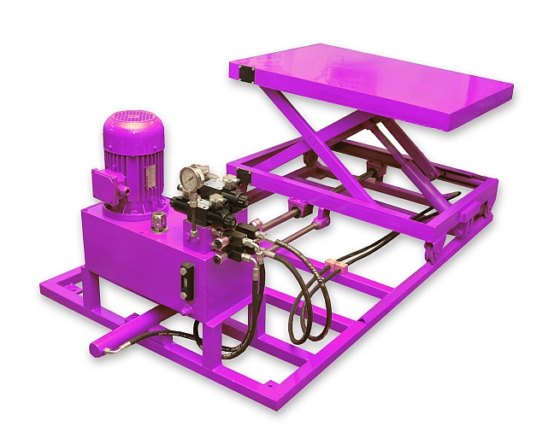
HYDRAULIC PLATFORM[8]

